Slide 1

Exploring Advanced Concepts in Git
Deep dive into complex version control techniques
Notes:
AI-generated content may be incorrect. ---

Slide 2
Introduction and Learning Objectives
Notes:
--- This slide references information from the following file: https://dell-my.sharepoint.com/personal/prakash_hikkanagutti_dell_com/Documents/Microsoft%20Copilot%20Chat%20Files/Lesson_03_Exploring_Advanced_Concepts_in_Git.pdf Learning Objectives

Slide 3

Learning Objectives
Issue Tracking and Management
Learners will create and track issues in GitHub to efficiently prioritize and manage development tasks.
Synchronizing Repositories
Setting up upstream connections helps synchronize local and remote repositories for seamless collaboration.
Tagging for Deployment
Understanding creation and deletion of tags enables controlled deployment and rollback in projects.
Advanced Workflow Techniques
Mastering stashing and rebasing maintains clean commit histories and handles complex workflows.
Notes:
--- This slide references information from the following file: https://dell-my.sharepoint.com/personal/prakash_hikkanagutti_dell_com/Documents/Microsoft%20Copilot%20Chat%20Files/Lesson_03_Exploring_Advanced_Concepts_in_Git.pdf By the end of this lesson, learners will be equipped with advanced Git skills that enhance collaboration and version control. The objectives include creating and tracking issues in GitHub to prioritize and manage tasks efficiently, setting up upstream connections to synchronize local and remote repositories, and understanding how to create and delete tags for deployment and rollback processes. Additionally, learners will master stashing and rebasing techniques to handle complex workflows and maintain clean commit histories. These objectives aim to provide practical knowledge for real-world scenarios, ensuring developers can manage repositories effectively, resolve conflicts, and maintain project integrity. Each concept will be reinforced through assisted practice exercises, enabling hands-on experience with Git commands and workflows.

Slide 4
Advanced Operations in Git
Notes:
--- This slide references information from the following file: https://dell-my.sharepoint.com/personal/prakash_hikkanagutti_dell_com/Documents/Microsoft%20Copilot%20Chat%20Files/Lesson_03_Exploring_Advanced_Concepts_in_Git.pdf Issue Tracking in GitHub, Upstream and Downstream

Slide 5

Issue Tracking in GitHub
Creating and Managing Issues
Users create issues for bugs, features, or tasks via repository, CLI, or code comments for better tracking.
Assigning and Labeling
Issues are assigned to team members and labeled by priority or type to organize workflow efficiently.
Milestones and Progress Tracking
Grouping issues under milestones helps teams monitor progress toward project goals effectively.
Collaboration and Communication
Collaborative communication within issues ensures transparency and accelerates problem resolution.
Notes:
--- This slide references information from the following file: https://dell-my.sharepoint.com/personal/prakash_hikkanagutti_dell_com/Documents/Microsoft%20Copilot%20Chat%20Files/Lesson_03_Exploring_Advanced_Concepts_in_Git.pdf Issue tracking in GitHub is a fundamental feature that helps teams plan, discuss, and monitor tasks, bugs, and enhancements. Users can create issues for bug reports, feature requests, or task discussions through multiple methods, such as directly from the repository, using GitHub CLI, or even from comments and code snippets. Tracking issues involves assigning them to team members, labeling them by priority or type, and grouping them under milestones to monitor progress toward goals. GitHub Projects provide a visual representation of workflows, enabling teams to organize tasks effectively. Communication within issues ensures transparency and collaboration, making it easier to resolve problems and implement improvements. This structured approach to issue management enhances productivity and accountability in software development projects.

Slide 6
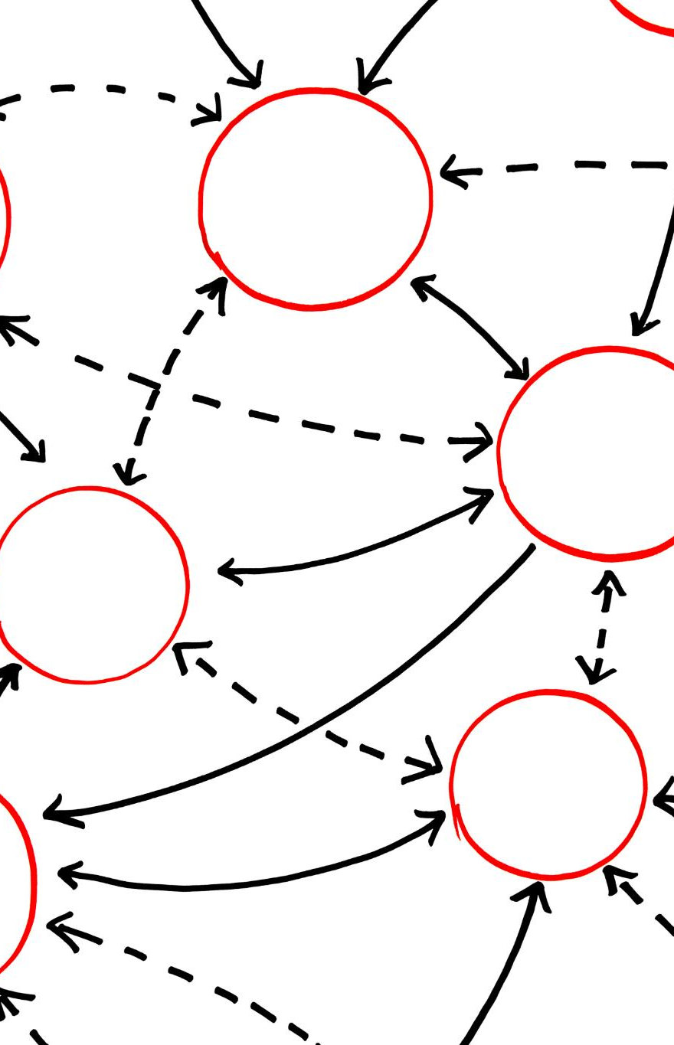
Upstream and Downstream
Definition of Upstream
Upstream repository refers to the original source or main project repository from which forks are created.
Definition of Downstream
Downstream repositories are local clones or forks where developers make changes and contribute back upstream.
Data Flow and Synchronization
Updates flow from upstream to downstream on pull, and contributions move from downstream to upstream via push or pull requests.
Importance of Upstream Remote
Setting an upstream remote helps fetch updates and keep forks aligned, reducing conflicts during collaboration.
Notes:
--- This slide references information from the following file: https://dell-my.sharepoint.com/personal/prakash_hikkanagutti_dell_com/Documents/Microsoft%20Copilot%20Chat%20Files/Lesson_03_Exploring_Advanced_Concepts_in_Git.pdf In Git, upstream and downstream concepts define the direction of data flow between repositories. The upstream repository typically refers to the original source, such as the main project repository or the one from which a fork was created. Downstream repositories include local clones or forks where developers make changes. Synchronization between these repositories is crucial for maintaining consistency. Changes flow from upstream to downstream when pulling updates, while contributions move from downstream to upstream through pushes or pull requests. Setting up an upstream remote ensures that developers can fetch updates from the original repository, reducing conflicts and keeping forks aligned with the main project. Understanding these concepts is essential for collaborative development and maintaining a clean workflow.

Slide 7
Git Tags and Branching
Notes:
--- This slide references information from the following file: https://dell-my.sharepoint.com/personal/prakash_hikkanagutti_dell_com/Documents/Microsoft%20Copilot%20Chat%20Files/Lesson_03_Exploring_Advanced_Concepts_in_Git.pdf Types and Operations of Git Tags, Branching vs Tagging

Slide 8

Types and Operations of Git Tags
Types of Git Tags
Git supports two tag types: lightweight tags are simple commit pointers; annotated tags include metadata such as author and date.
Common Tag Operations
Tag operations include creating, listing, pushing to remotes, and deleting tags to manage project versions effectively.
Importance of Git Tags
Tags help mark stable project points for deployment or rollback, improving clarity and traceability in releases.
Notes:
--- This slide references information from the following file: https://dell-my.sharepoint.com/personal/prakash_hikkanagutti_dell_com/Documents/Microsoft%20Copilot%20Chat%20Files/Lesson_03_Exploring_Advanced_Concepts_in_Git.pdf Git tags serve as markers within the commit history, often used to denote releases or significant milestones. There are two types of tags: lightweight and annotated. Lightweight tags are simple pointers to commits without additional metadata, while annotated tags include details such as the tagger’s name, email, date, and an optional message. Tag operations include creating tags using the 'git tag' command, listing existing tags, pushing tags to remote repositories for shared visibility, and deleting tags when they are no longer needed. Tags are crucial for version control, enabling developers to identify stable points in the project history for deployment or rollback purposes. Proper use of tags ensures clarity and traceability in software releases.

Slide 9
Branching vs Tagging
Aspect | Branching | Tagging
Definition | Pointers to commits for parallel development | References to specific commits for milestones
Nature | Dynamic, moves forward with new commits | Static, fixed at creation point
Example | Feature branch for new functionality | Tag marking a stable release
Notes:
--- This slide references information from the following file: https://dell-my.sharepoint.com/personal/prakash_hikkanagutti_dell_com/Documents/Microsoft%20Copilot%20Chat%20Files/Lesson_03_Exploring_Advanced_Concepts_in_Git.pdf Branching and tagging in Git serve different purposes. Branches are dynamic pointers that allow parallel development, enabling teams to work on features or fixes independently. They evolve as new commits are added, supporting iterative development. Tags, on the other hand, are static references to specific commits, typically used to mark release points or significant milestones. While branches facilitate ongoing work, tags provide historical checkpoints for versioning. For example, a feature branch might be created to develop a new functionality, whereas a tag would mark a commit as a stable release version. Understanding these distinctions helps developers manage workflows effectively and maintain a clear project history.

Slide 10
Stashing and Rebasing
Notes:
--- This slide references information from the following file: https://dell-my.sharepoint.com/personal/prakash_hikkanagutti_dell_com/Documents/Microsoft%20Copilot%20Chat%20Files/Lesson_03_Exploring_Advanced_Concepts_in_Git.pdf Stashing in Git, Rebasing in Git

Slide 11

Stashing in Git
Purpose of Git Stashing
Git stashing temporarily saves uncommitted changes to keep the working directory clean when switching branches or tasks.
git stash Command Functionality
The 'git stash' command stores both staged and unstaged changes and resets the directory to the last commit.
Applying vs Popping Stash
Applying restores changes while keeping stash; popping restores and removes stash from stack.
Maintaining Workflow Continuity
Stashing allows developers to handle urgent tasks without losing progress on ongoing work.
Notes:
--- This slide references information from the following file: https://dell-my.sharepoint.com/personal/prakash_hikkanagutti_dell_com/Documents/Microsoft%20Copilot%20Chat%20Files/Lesson_03_Exploring_Advanced_Concepts_in_Git.pdf Stashing in Git allows developers to temporarily save uncommitted changes without committing them, which is useful when switching branches or performing operations that require a clean working directory. The 'git stash' command stores both staged and unstaged changes, resetting the working directory to the last commit. Developers can later apply or pop the stash to restore changes. Applying keeps the stash in the stack for future use, while popping removes it after restoration. This feature is particularly helpful in maintaining workflow continuity, enabling developers to handle urgent tasks without losing progress on ongoing work.

Slide 12
Rebasing in Git
Linear Project History
Rebasing integrates commits onto a new base, creating a simplified, linear commit history.
Interactive Rebase Features
The 'git rebase' command allows editing, reordering, and squashing commits during the rebase process.
Benefits and Cautions
Rebasing keeps histories clean and reduces merge conflicts but should be used carefully to avoid issues.
Notes:
--- This slide references information from the following file: https://dell-my.sharepoint.com/personal/prakash_hikkanagutti_dell_com/Documents/Microsoft%20Copilot%20Chat%20Files/Lesson_03_Exploring_Advanced_Concepts_in_Git.pdf Rebasing is a process of integrating commits from one branch onto another base tip, creating a linear project history. It involves taking all commits from a feature branch and appending them to the commits of the target branch. This simplifies the commit graph, making it easier to trace changes from feature completion back to the start. The 'git rebase' command supports interactive options for editing, reordering, or squashing commits during the process. Rebasing is ideal for maintaining clean histories but should be used cautiously to avoid rewriting shared history. It enhances clarity and reduces merge conflicts in collaborative projects.

Slide 13
Undoing and Inspecting Changes
Notes:
--- This slide references information from the following file: https://dell-my.sharepoint.com/personal/prakash_hikkanagutti_dell_com/Documents/Microsoft%20Copilot%20Chat%20Files/Lesson_03_Exploring_Advanced_Concepts_in_Git.pdf Revert, Reset, and Remove, Diff and Status

Slide 14

Revert, Reset, and Remove
Git Revert Command
'git revert' creates a new commit to reverse changes while preserving project history and collaboration integrity.
Git Reset Command
'git reset' moves HEAD to a previous commit with options controlling how changes are discarded or kept.
Git Remove Files
'git rm' removes files from the working directory and staging area, helping clean up repositories.
Notes:
--- This slide references information from the following file: https://dell-my.sharepoint.com/personal/prakash_hikkanagutti_dell_com/Documents/Microsoft%20Copilot%20Chat%20Files/Lesson_03_Exploring_Advanced_Concepts_in_Git.pdf Git provides several commands to undo changes and inspect repository states. 'git revert' creates a new commit that reverses changes from a specified commit, preserving history. 'git reset' moves the HEAD to a previous commit, with options like --soft, --mixed, and --hard to control the extent of changes discarded. 'git rm' removes files from both the working directory and the staging area, useful for cleaning up unwanted files. These commands enable developers to manage errors, restore previous states, and maintain repository integrity without compromising collaboration.

Slide 15

Diff and Status
Git Diff Functionality
The 'git diff' command shows changes between working directory, staging area, and commits for code review.
Diff Command Options
Options like --cached and --stat customize the output of 'git diff' for detailed change insights.
Git Status Overview
'git status' shows current state of files, including tracked, untracked, and modified ones.
Notes:
--- This slide references information from the following file: https://dell-my.sharepoint.com/personal/prakash_hikkanagutti_dell_com/Documents/Microsoft%20Copilot%20Chat%20Files/Lesson_03_Exploring_Advanced_Concepts_in_Git.pdf The 'git diff' command displays differences between various states, such as the working directory, staging area, and commits. It helps developers review changes before committing or merging. Options like --cached and --stat provide flexibility in output. 'git status' shows the current state of the working directory and staging area, indicating tracked, untracked, and modified files. These commands are essential for monitoring progress, identifying pending changes, and ensuring accuracy before executing critical operations.

Slide 16
Key Takeaways and Project Agenda
Notes:
--- This slide references information from the following file: https://dell-my.sharepoint.com/personal/prakash_hikkanagutti_dell_com/Documents/Microsoft%20Copilot%20Chat%20Files/Lesson_03_Exploring_Advanced_Concepts_in_Git.pdf Key Takeaways, Project Agenda

Slide 17

Key Takeaways
Advanced Git Operations
Issue tracking, tagging, stashing, and rebasing enhance version control efficiency and collaborative workflows.
Maintaining Clean Histories
Using upstream management and undoing changes ensures clean project histories and stability.
Empowering Developers
Mastering these Git techniques helps resolve conflicts and deliver high-quality software efficiently.
Notes:
--- This slide references information from the following file: https://dell-my.sharepoint.com/personal/prakash_hikkanagutti_dell_com/Documents/Microsoft%20Copilot%20Chat%20Files/Lesson_03_Exploring_Advanced_Concepts_in_Git.pdf Advanced Git operations such as issue tracking, upstream management, tagging, stashing, rebasing, and undoing changes are vital for efficient version control and collaboration. These techniques help maintain clean histories, manage workflows, and ensure project stability. Understanding and applying these concepts empowers developers to handle complex scenarios, resolve conflicts, and deliver high-quality software.

Slide 18
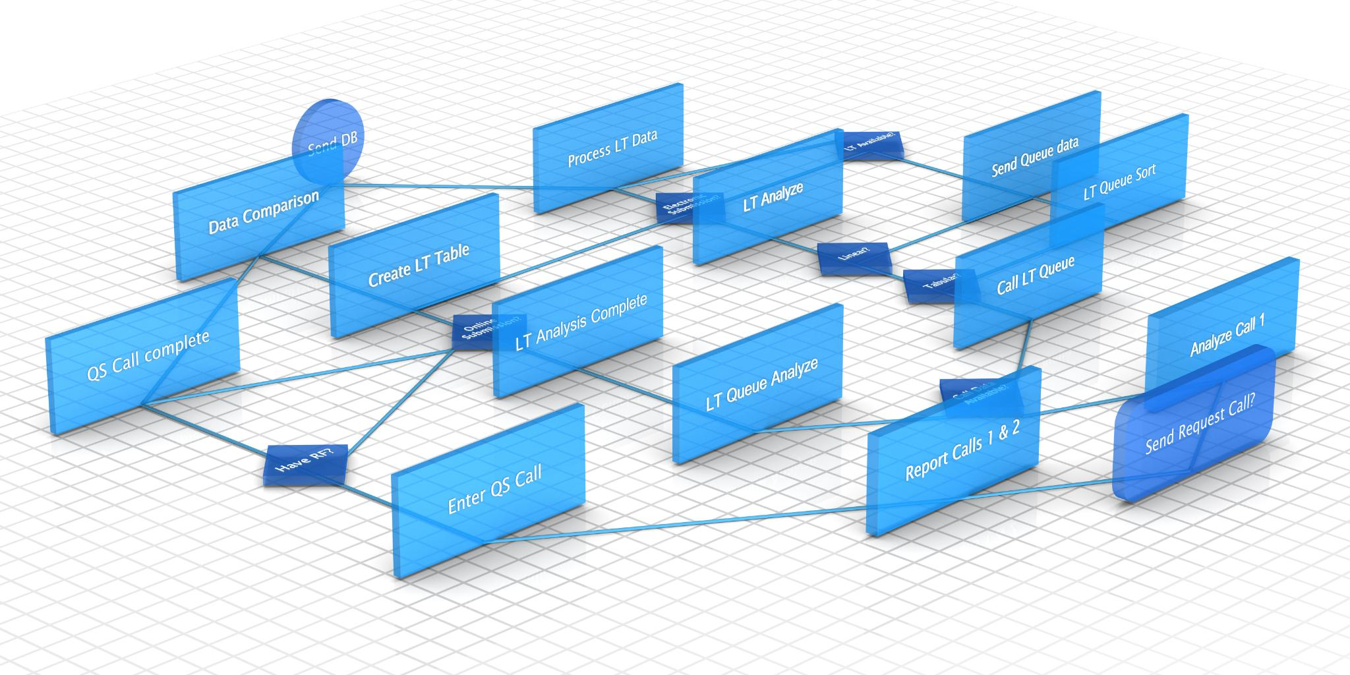
Project Agenda
Repository Creation
Starting the project by creating a new Git repository named Codex for version control.
Branch and Tag Management
Creating branches and adding tags to organize development and mark important milestones.
Commit Reversion and Rebasing
Reverting previous commits and rebasing branches to maintain a clean and linear history.
Index File Removal
Removing files from the Git index to manage tracked content efficiently.
Notes:
--- This slide references information from the following file: https://dell-my.sharepoint.com/personal/prakash_hikkanagutti_dell_com/Documents/Microsoft%20Copilot%20Chat%20Files/Lesson_03_Exploring_Advanced_Concepts_in_Git.pdf The project involves executing advanced Git operations on a repository named Codex. Tasks include creating a new repository, adding tags, creating branches, reverting commits, rebasing branches, and removing files from the index. These exercises aim to reinforce theoretical knowledge through practical implementation, enhancing proficiency in Git workflows and collaboration strategies.

